Slide 1
Challenges with Anomaly Detection
Notes:
Lets take an industry case study

Slide 2
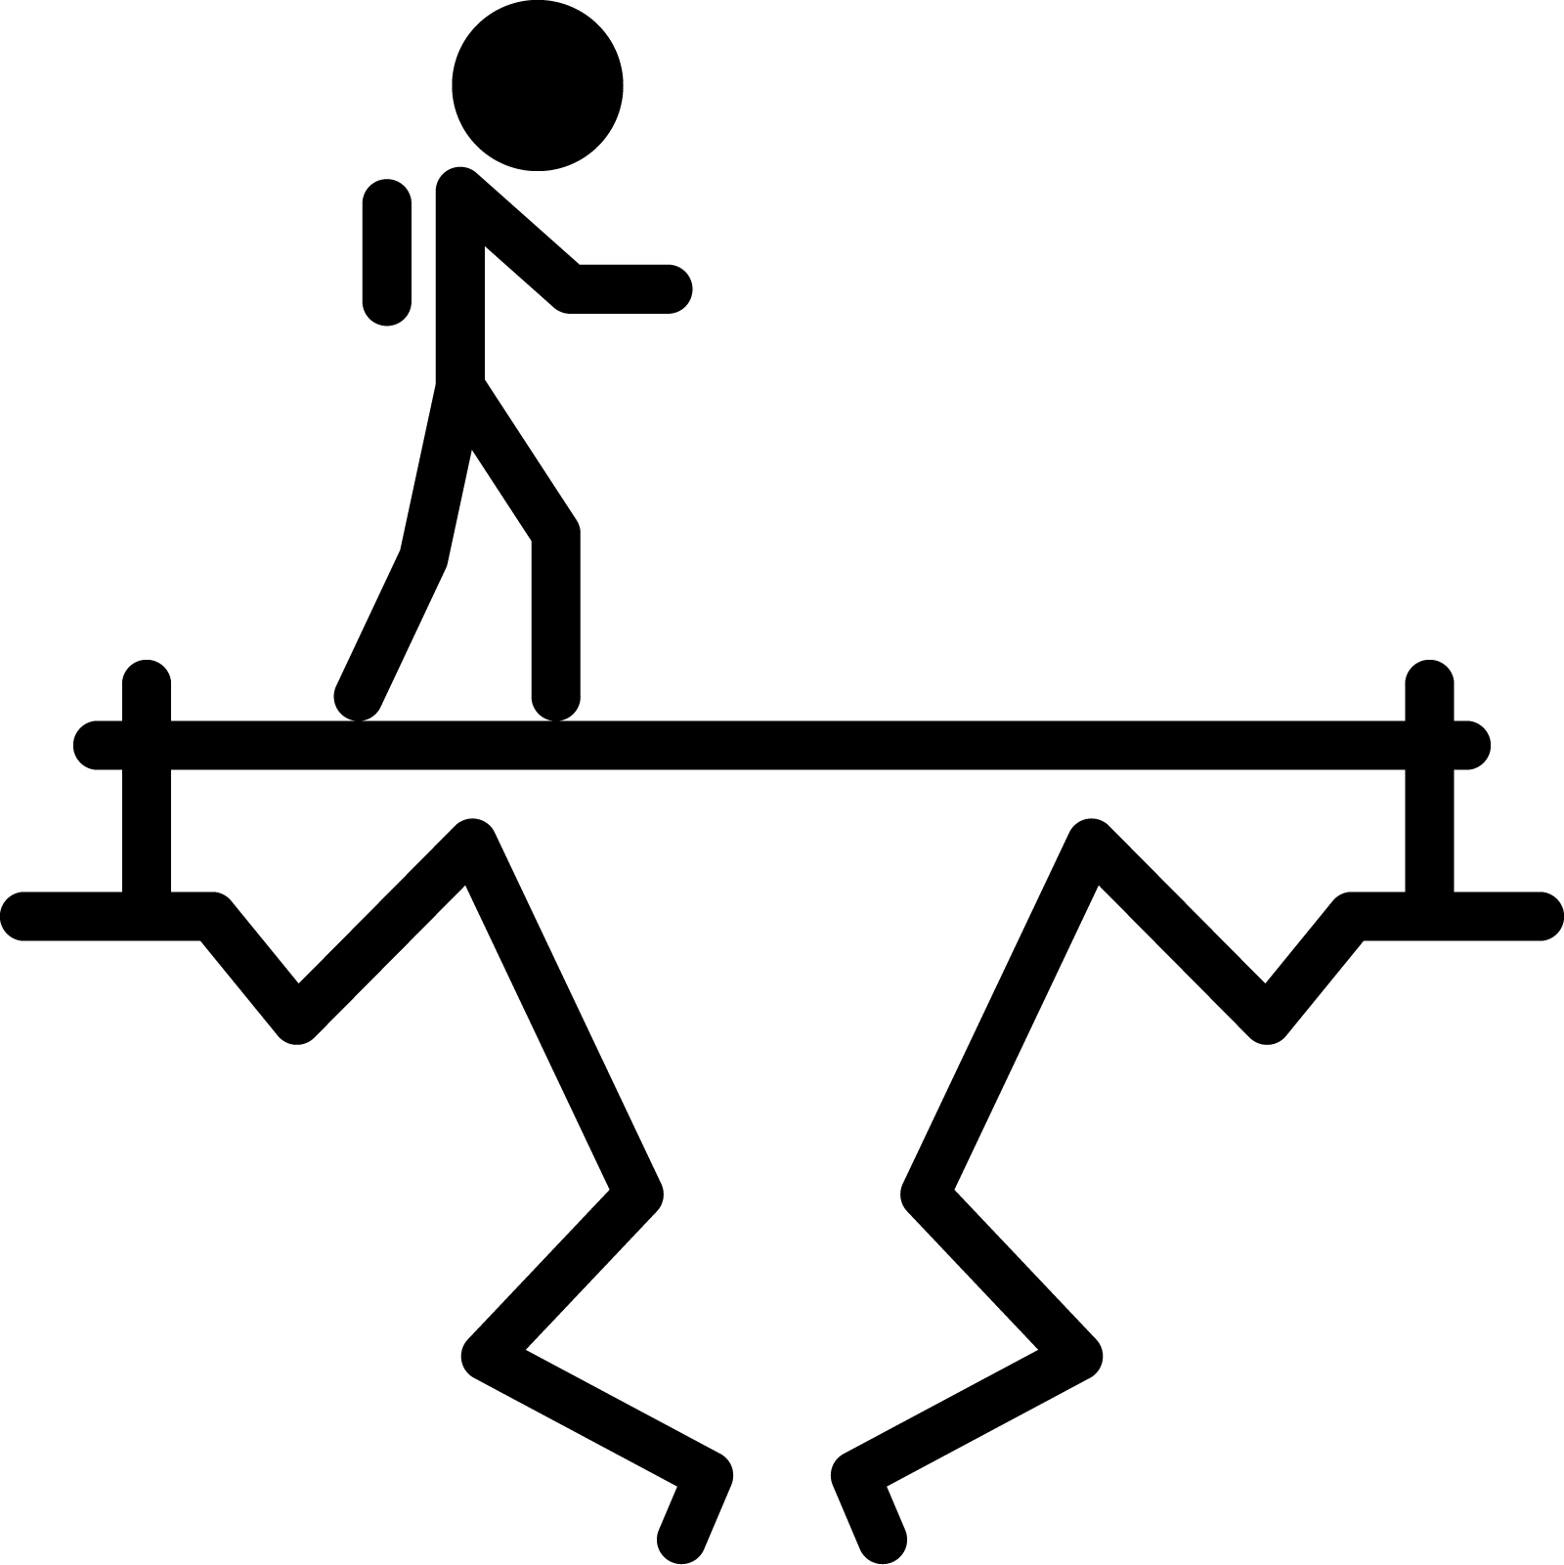


What are we going to learn?
Collect and Preprocess Data
Design
and Train
Model
Evaluate, Optimize, Convert, Deploy
Make
Inferences
Micro
Challenges with an Anomaly Detection Application
Anomaly Detection ML Pipeline
Training, Testing
in Colab
Notes:
Challenges = Bandwidth, Battery, Latency, Accuracy, Datasets
The AD ML Pipeline = Real World case studies of how to anomaly detection implemented in industry
Hands-on training and of anomaly detection models in Colab!

Slide 3
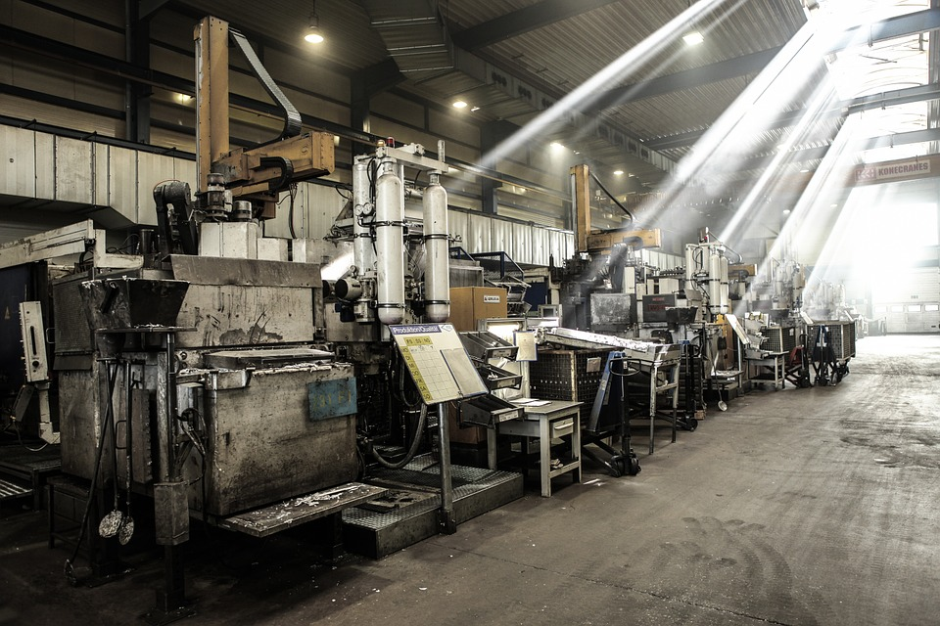
Application: Factory machinery
Notes:
The benefits of predictive maintenance are reducing the cost of replacements and increasing the safety of systems.
https://pixabay.com/photos/factory-hall-production-machines-671598/

Slide 4
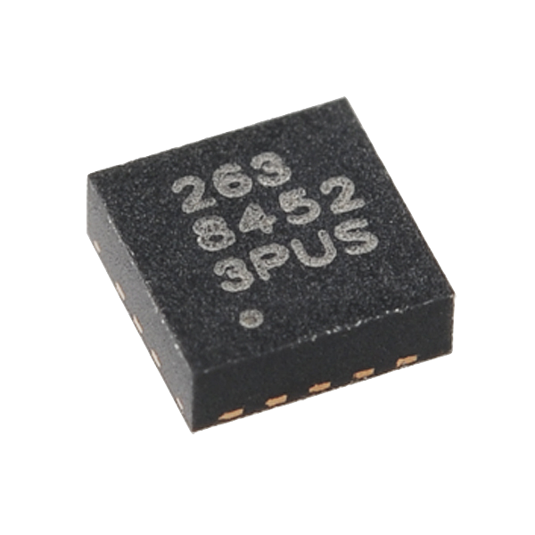
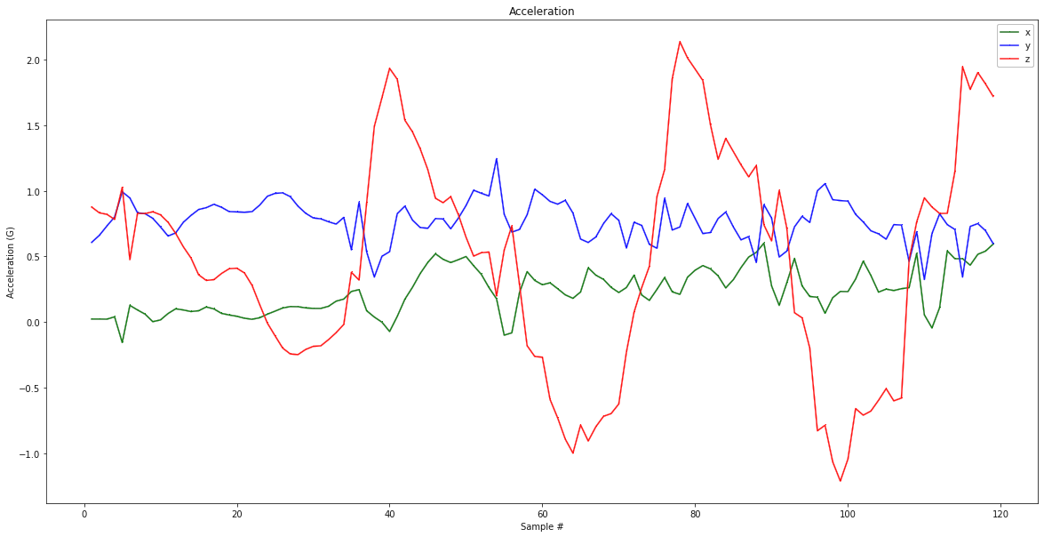
Sensor: Accelerometer
Notes:
Make our own sensor to predict malfunctions by placing two accelerometers on each bearing mount (x and y axis). We can easily collect a dataset of normal operating conditions but it is prohibitively expensive to collect data on all possible failure states.
An accelerometer is a simple sensor that measures the acceleration force on a single axis.
https://commons.wikimedia.org/wiki/File:FreescaleSemiconductor_3-Axis-MEMS-Accelerometer_MMA8452Q_10953-01b.jpg

Slide 5

Constraints for on-device computing
Latency
Notes:
This brings it’s own set of challenges we need to face.
We need to process data quickly
Fit within the limits of the tiny device
And we need to be accurate in our predicitons

Slide 6


Constraints for on-device computing
Latency
Limited Devices
Notes:
This brings it’s own set of challenges we need to face.
We need to process data quickly
Fit within the limits of the tiny device
And we need to be accurate in our predicitons

Slide 7

Constraints for on-device computing
Latency
Limited Devices
Accuracy
Notes:
This brings it’s own set of challenges we need to face.
We need to process data quickly
Fit within the limits of the tiny device
And we need to be accurate in our predicitons

Slide 8
Constraints for on-device computing
Latency
Limited Devices
Accuracy
Notes:
This brings it’s own set of challenges we need to face.
We need to process data quickly
Fit within the limits of the tiny device
And we need to be accurate in our predicitons

Slide 9
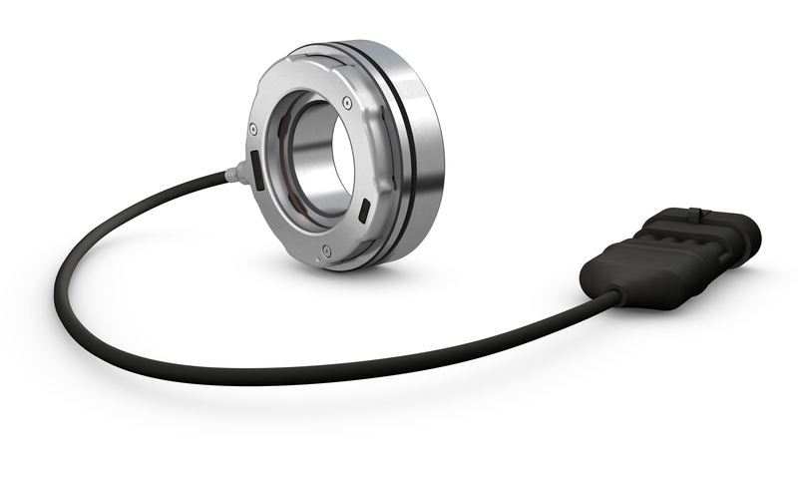
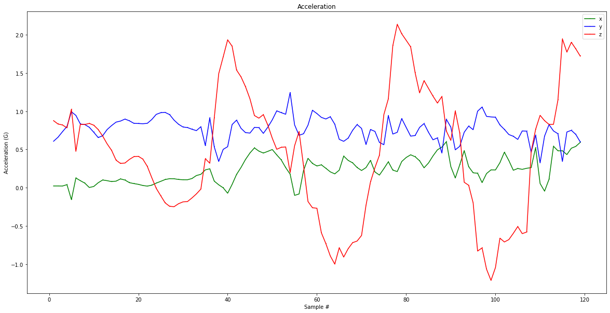
Real Time Constraint
?
Pre-processing
Notes:
Latency is critical because we must keep up with the sample rate of the sensors.

Slide 10
It’s too expensive
to stream to the cloud
2 bytes ✕ 8 ✕ 20kHz = 320 KB / sec
Measurement
Sample Rate
# Sensors

Slide 11
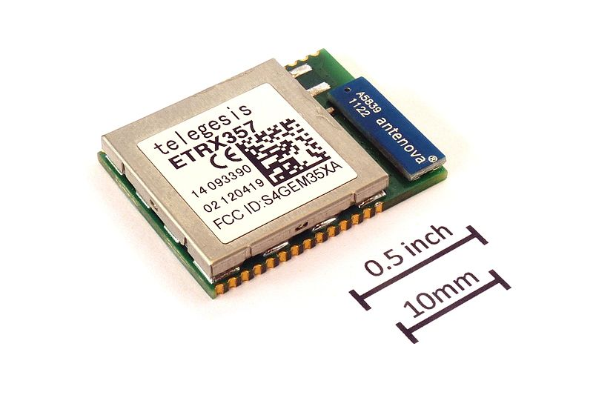
It’s too expensive
to stream to the cloud
2 bytes ✕ 8 ✕ 20kHz = 320 KB / sec
30 KB/s MAX
Notes:
A zigbee radio, which is commonly used for wireless sensor networks, reaches only about 30 Kbytes/s. This means we would be producing data faster than we can transmit it.
Additionally, a zigbee radio consumes about 1 joule per second(cite) at that rate which would deplete a standard coin cell battery in about 40 minutes
https://commons.wikimedia.org/wiki/File:ETRX357_ZigBee_module_with_size_ref.JPG

Slide 12
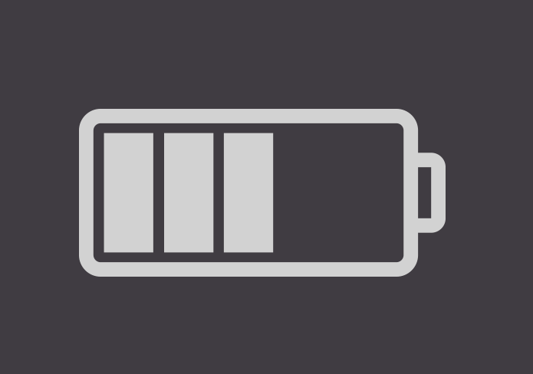
It’s too expensive
to stream to the cloud
2 bytes ✕ 8 ✕ 20kHz = 320 KB / sec
>
30 KB / sec
30 KB/s MAX
Notes:
A zigbee radio, which is commonly used for wireless sensor networks, reaches only about 30 Kbytes/s. This means we would be producing data faster than we can transmit it.
Additionally, a zigbee radio consumes about 1 joule per second(cite) at that rate which would deplete a standard coin cell battery in about 40 minutes
https://commons.wikimedia.org/wiki/File:ETRX357_ZigBee_module_with_size_ref.JPG

Slide 13

Need “intelligence”
close to sensors
Notes:
This motivates bringing intelligence close to the sensor, AKA tinyML
https://thenounproject.com/search/?q=machine+learning&i=2010152

Slide 14
Constraints for on-device computing
Latency
Limited Devices
Accuracy
Notes:
Fit within the limits of the tiny device

Slide 15
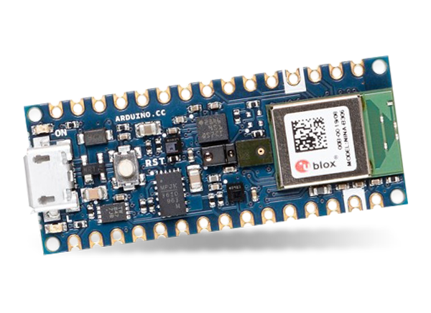
Very Small (Tiny) Devices
Cost ($)
✔
Power (W)
✔
✔
Our board [Course 3 Kit] only has 256KB of RAM (memory)
Eng. Effort
Notes:
Cost and energy constraints make using very small MCUs attractive but that adds additional challenges like limited memory

Slide 16
Constraints for on-device computing
Latency
Limited Devices
Accuracy
Notes:
And we need to be accurate in our predicitons

Slide 17
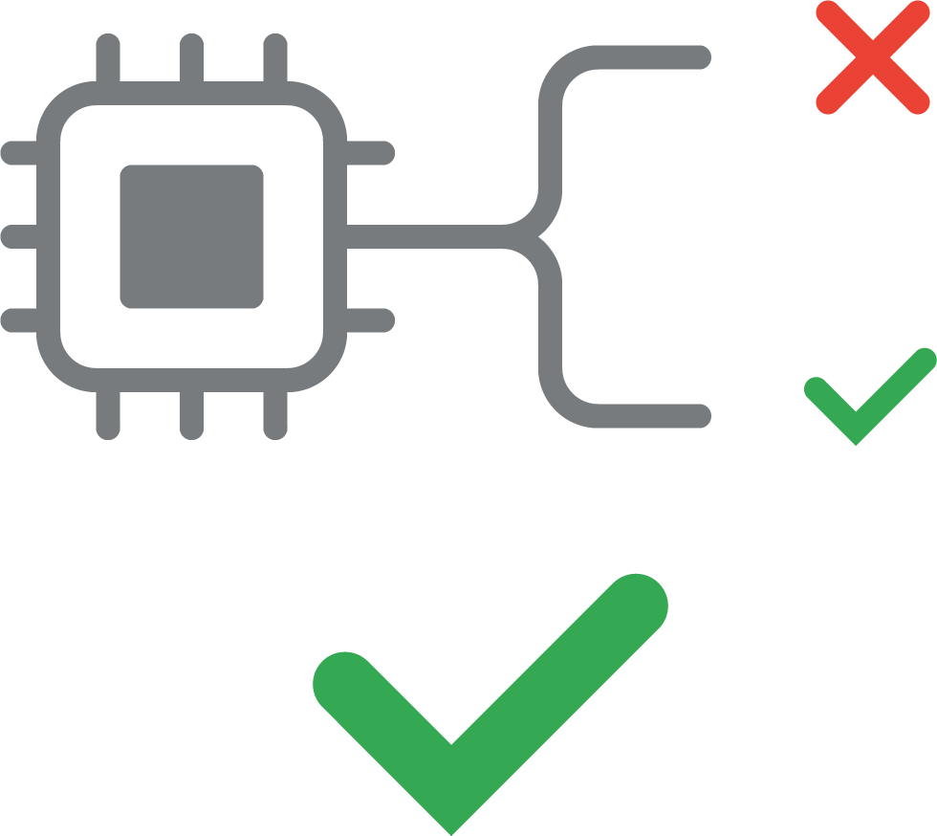
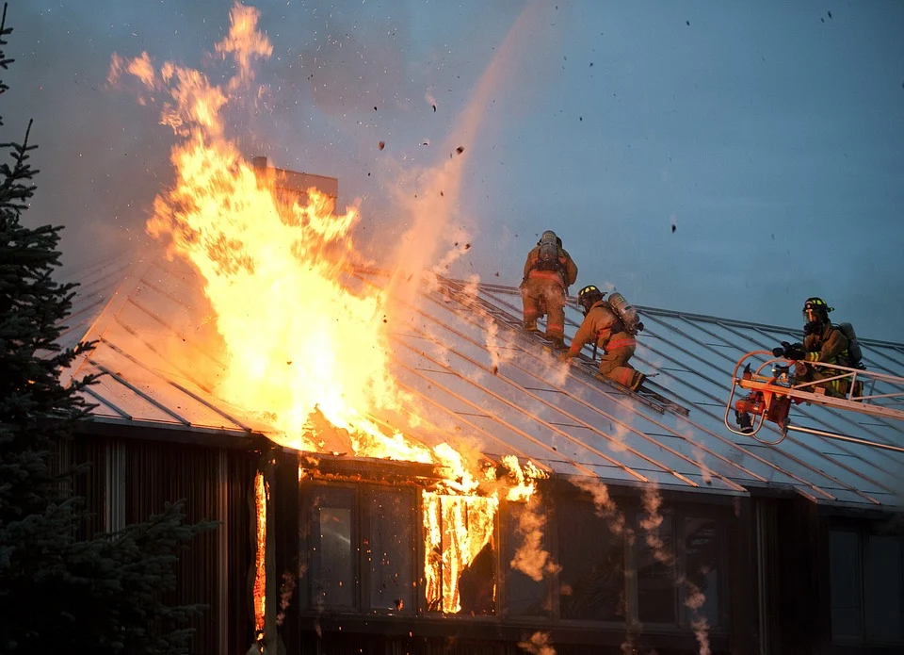
False Negative
Catastrophic impact
Notes:
If a system misses a anomaly it can lead to disaster if nothing else catches that mistake
https://pixabay.com/photos/fire-flames-building-house-home-89353/
https://thenounproject.com/search/?q=false+positive&i=2985145

Slide 18
False Negative
ERROR
Catastrophic impact
REAL
Notes:
If a system misses a anomaly it can lead to disaster if nothing else catches that mistake
https://pixabay.com/photos/fire-flames-building-house-home-89353/
https://thenounproject.com/search/?q=false+positive&i=2985145

Slide 19

False Positive
False alarm, cost impact
$
Notes:
Applications can either alert a person or take some action directly, like stopping the machinery
If alarms are triggered too often people will ignore them
If machinery is stopped to often it will cost time and money
https://thenounproject.com/search/?q=false+positive&i=2985145
https://thenounproject.com/term/ignore-notification/492142/

Slide 20
False Positive
ERROR
False alarm, cost impact
$
REAL
Notes:
Applications can either alert a person or take some action directly, like stopping the machinery
If alarms are triggered too often people will ignore them
If machinery is stopped to often it will cost time and money
https://thenounproject.com/search/?q=false+positive&i=2985145
https://thenounproject.com/term/ignore-notification/492142/

Slide 21
Notes:
There are many more applications of tinyML in industry. Next you will read about a few other unique real world examples

Slide 22
Impact of a False Negative
Notes:
If a system misses a anomaly it can lead to disaster if nothing else catches that mistake

Slide 23

Impact of a False Positive
$
Notes:
Applications can either alert a person or take some action directly, like stopping the machinery
If alarms are triggered too often people will ignore them
If machinery is stopped to often it will cost time and money

Slide 24
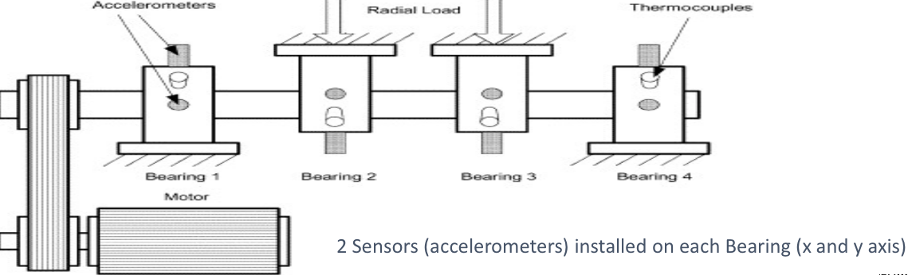
Bearing Monitoring
Temp image taken from: https://iot.ieee.org/images/files/pdf/phm2017/06-19-2017-Rick-Durham_IEEE-PHM_Presentation20170610.pdf
Notes:
We want to be able to monitor the health of 4 bearings in a crankshaft to be able to predict malfunctions and possible failures. We place two accelerometers on each bearing mount (x and y axis). We can easily collect a dataset of normal operating conditions but it is prohibitively expensive to collect data on all possible failure states.

Slide 25
It’s too expensive
to stream to the cloud
2 byte measurement
8 Sensors
20 KHz
sample rate
320 KB/S
>
30 KB/S
Notes:
A zigbee radio, which is commonly used for wireless sensor networks, reaches only about 30 Kbytes/s. This means we would be producing data faster than we can transmit it.
Additionally, a zigbee radio consumes about 1 joule per second(cite) at that rate which would deplete a standard coin cell battery in about 40 minutes

Slide 26
It’s too expensive
to stream to the cloud
2 byte measurement
8 Sensors
20 KHz
sample rate
320 KB/S
>
30 KB/S
Notes:
A zigbee radio, which is commonly used for wireless sensor networks, reaches only about 30 Kbytes/s. This means we would be producing data faster than we can transmit it.
Additionally, a zigbee radio consumes about 1 joule per second(cite) at that rate which would deplete a standard coin cell battery in about 40 minutes
https://commons.wikimedia.org/wiki/File:ETRX357_ZigBee_module_with_size_ref.JPG

Slide 27

It’s too expensive to stream to the cloud
2 byte measurement
8 Sensors
20 KHz
sample rate
320 KB/S
>
30 KB/S
Notes:
A zigbee radio, which is commonly used for wireless sensor networks, reaches only about 30 Kbytes/s. This means we would be producing data faster than we can transmit it.
Additionally, a zigbee radio consumes about 1 joule per second(cite) at that rate which would deplete a standard coin cell battery in about 40 minutes

Slide 28
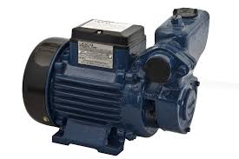
Real Time Constraint
?
Pre-Processing
Notes:
Latency is critical because we must keep up with the sample rate of the sensors.

